Slide 1

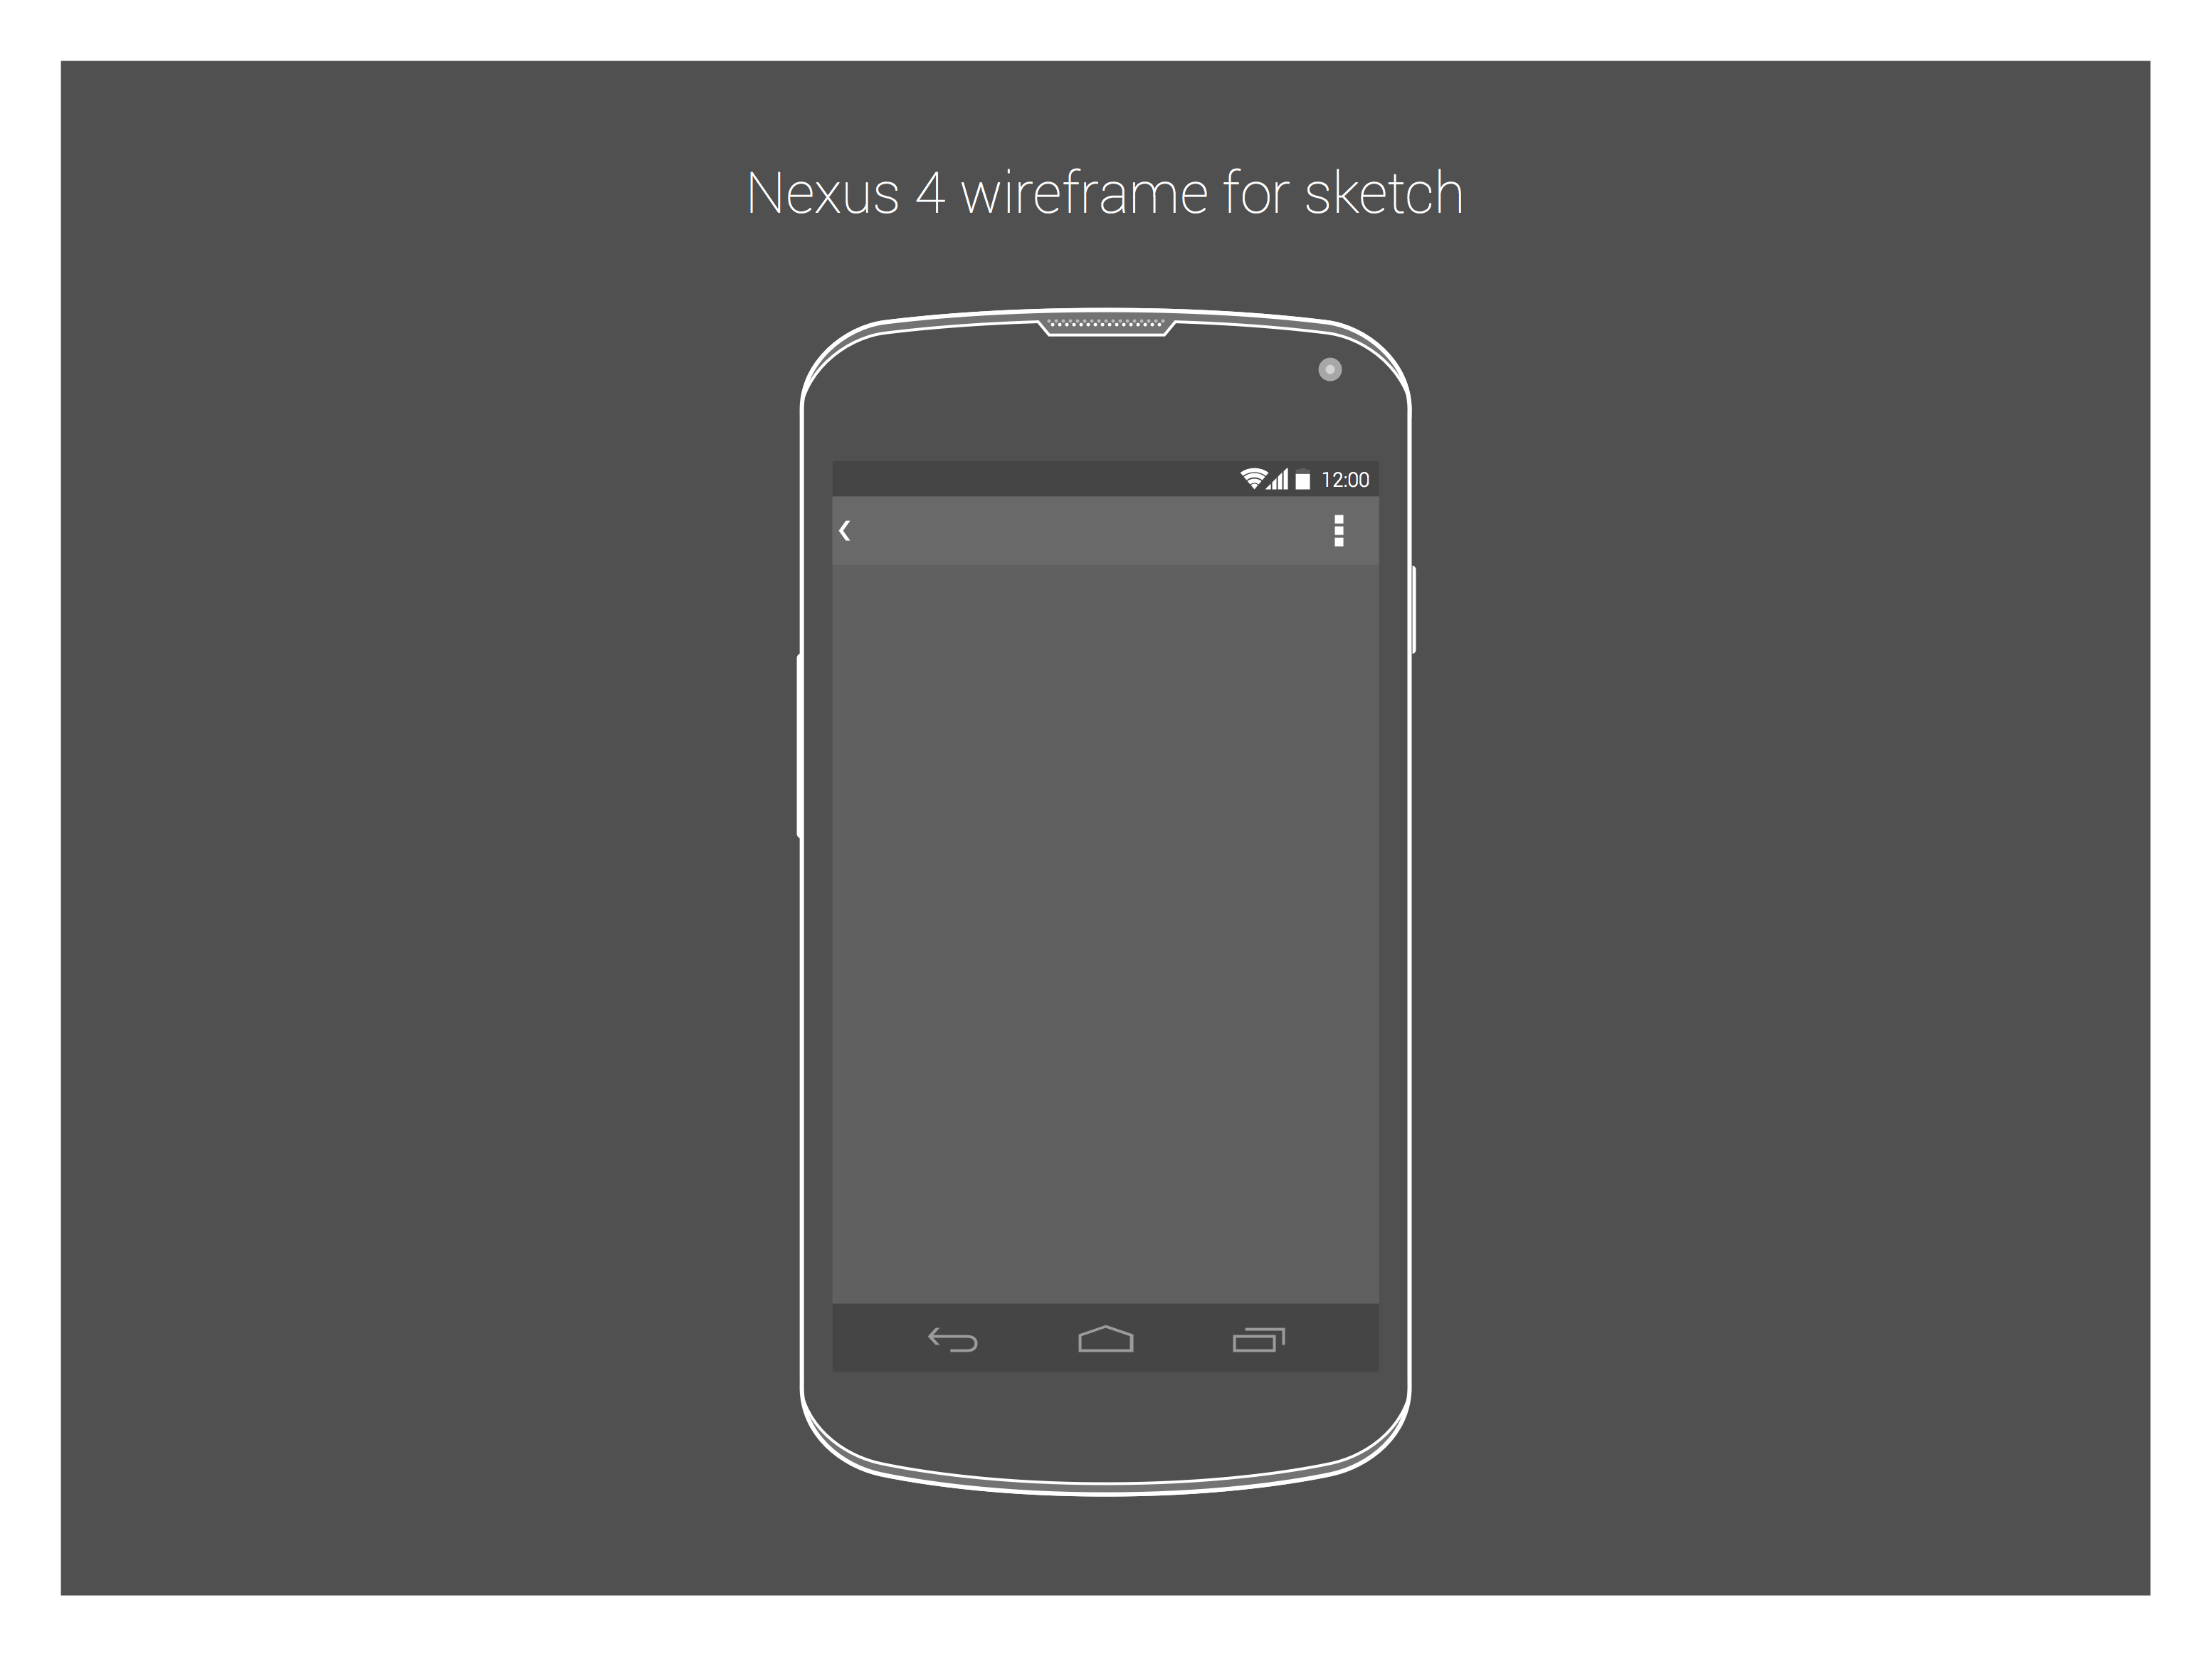
Mood Music
Play what you feel
Notes:
Hi this is Raul, this is Mariana and I’m Stephen. Together we are Mood Music.

Slide 2
Problem being solved
Notes:
The problem Mood Music seeks to solve is that current media players don’t allow you to quickly delve into a stream of music based upon how you feel. They force you to search for playlists or specific songs or present you with choices of songs you might like. None which might do the trick.

Slide 3
Do people really choose music by emotions?
Notes:
Yes
Report in the US by the Journal of Consumer Research found that people who were frustrated liked angry music amongst other findings.
We did a survey which found….
And ask yourself. What is at the core of determining what you listen to at any one moment. I‘d wager its your mood.

Slide 4
“We’re always in a mood”
Claudio Ciborra, Organizational Theorist
Notes:
Yes
Report in the US by the Journal of Consumer Research found that people who were frustrated liked angry music amongst other findings.
We did a survey which found….
And ask yourself. What is at the core of determining what you listen to at any one moment. I‘d wager its your mood.

Slide 5

Mood
Music
Notes:
So our solutions is an app called Mood Music. It‘s now available on Android.

Slide 6
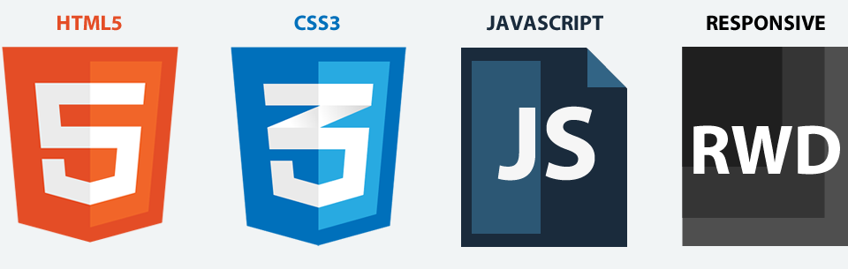
Which languages?
Notes:
It has been built with Javascript…

Slide 7


Which APIs?
Notes:
And we have used the Connect API from Getty and Soundcloud’s API

Slide 8
So… what have you created?
Notes:
Mood Music puts choosing your music by your mood – or the mood you want to be in – front and centre. We combine beautiful photos from Getty with incredible music from Sound Cloud.
Let me introduce the app through a story as if you had it, when you arrived at Seedhack.

Slide 9

Mood Music
Play what you feel
Try it out: 10.100.93.236:8000

